Slide 1


Chief Officer Mental Health Symposium
Drs. Audrey Martinez and Krystle Madrid
LAFD Behavioral Health Program

Slide 2
Staff and Contact Information
LAFD Behavioral Health Program
  Clinical Staff
    Dr. Krystle Madrid, Psy.D.
    Dr. Audrey Martinez, Ph.D.
  Administrative Staff
    Christina Arellano
  Scheduling
    (213) 202-5433
    (323) 276-7169
    Lafd.bhp@lacity.org

Slide 3


“If you don't take time for your wellness, you will be forced to take time for your illness.”
--Joyce Sunada
Notes:
Starting with the most important area, stress management.

Slide 4
Objectives
To provide stress management tips
To provide foundational relationship information and strategies to strengthen interpersonal bonds

Slide 5
Untreated Mental Health Conditions
Untreated mental health conditions may make it difficult to form relationships, keep relationships, and manage stress.
Before we dive into stress management, let’s talk about the ACEs…

Slide 6


ACE

Slide 7
Cleaning Up Your Past
ACE
  Video
  Your past impacts your present.
  Clean it up.
Notes:
https://www.youtube.com/watch?v=EBpF8sWycQQ

Slide 8
Stress Management
Stress-reaction to tension, demands, change and/or threat, real or imagined.
We have an innate alarm system that detects danger, which triggers the Fight-Flight-Freeze response
Stress is subjective
Can be short-term, long-term, or come in episodes (episodic stress)
Sources of stress:
  Environment
  Social
What are your sources of stress? LET’S CHAT.

Slide 9
Perceived Stress Scale
For each question choose from the following:
0 - Never
1 - Almost Never
2 - Sometimes
3 - Fairly Often
4 - Very Often
________ l. In the last month, how often have you been upset because of something that happened unexpectedly?
________ 2. In the last month, how often have you felt that you were unable to control the important things in your life?
________ 3. In the last month, how often have you felt nervous and stressed?
________ 4. In the last month, how often have you felt confident about your ability to handle your personal problems?
________ 5. In the last month, how often have you felt that things were going your way?
________ 6. In the last month, how often have you found that you could not cope with all the things that you had to do?
________ 7. In the last month, how often have you been able to control irritations in your life?
________ 8. In the last month, how often have you felt that you were on top of things?
________ 9. In the last month, how often have you been angered because of things that happened that were outside of your control?
________ 10. In the last month, how often have you felt difficulties were piling up so high that you could not overcome them?
Notes:
Source: State of New Hampshire Employee Assistance Program

Slide 10
What Is Your Score?
First, reverse your scores for questions 4, 5, 7, and 8. On these 4 questions, change the scores like this: 0 = 4, 1 = 3, 2 = 2, 3 = 1, 4 = 0.
Now add up your scores for each item to get a total.
My total score is ___________.
Individual scores on the PSS can range from 0 to 40 with higher scores indicating higher perceived stress.
    ► Scores ranging from 0-13 would be considered low stress.
    ► Scores ranging from 14-26 would be considered moderate stress.
    ► Scores ranging from 27-40 would be considered high perceived stress.
Notes:
Do you need to make some changes?

Slide 11
Stress Management
Before we manage your stress, let’s do another inventory to see what behaviors you are currently doing that you may need to change…

Slide 12
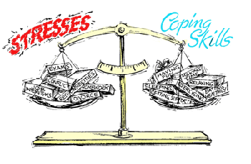
Coping Inventory
I ignore my own needs and just work harder and faster.
I seek out friends for conversation.
I eat more than usual.
I do some type of physical exercise.
I get irritable and take it out on those around me.
I take time to relax and, breathe, and unwind.
.
This Photo by Unknown Author is licensed under CC BY-SA

Slide 13
Coping Inventory
I smoke a cigarette or drink a caffeinated beverage.
I confront my source of stress and work to change it.
I withdraw emotionally and just go through the motions of the day.
I change my outlook on the problems and put things into perspective.
I sleep more than I really need to.
I take some time off and get away from my working life.

Slide 14
Coping Inventory
I go buy things to make myself feel good.
I joke with my friends and use humor to take the edge off.
I drink more than usual.
I get involved in a hobby or interest that helps me unwind.
I take medicine to help me relax or sleep.
I maintain a healthy diet.
I just ignore problems and hope they go away.
I pray, meditate, or enhance my spiritual life.
I worry about the problem and am afraid to do something about it.
I try to focus on the things I can control and accept the things I cannot.
Notes:
Evens are good coping tactics. Good job. Keep these behaviors up!
Odds are negative coping tactics. Those are areas to focus on changing.

Slide 15
Impacts of Stress on Physical and Mental Health
Headaches
Heartburn
High blood pressure
Increased respiration
Higher blood sugar levels
Weakened immune functioning
Gastrointestinal problems
Fertility problems
Lower sex drive
Erectile dysfunction
Increased risk of heart attack
Obesity
Hair loss
Acne
Mental health problems

Slide 16

Stress Management
Stress impacts you physically, emotionally, and mentally.
In fact, physical sensations, behaviors, emotions, and thoughts are all related and influence one another bidirectionally.
  So, a change in one area can bring about change in other areas.
Also remember, stress is subjective. Stress management is about helping you both cope with your stressor and having a different relationship with it.
Let’s examine coping on the three different channels: physical, emotional, cognitive

Slide 17

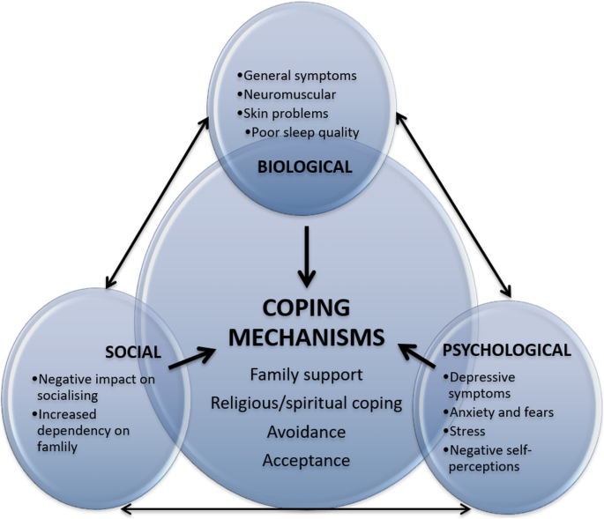
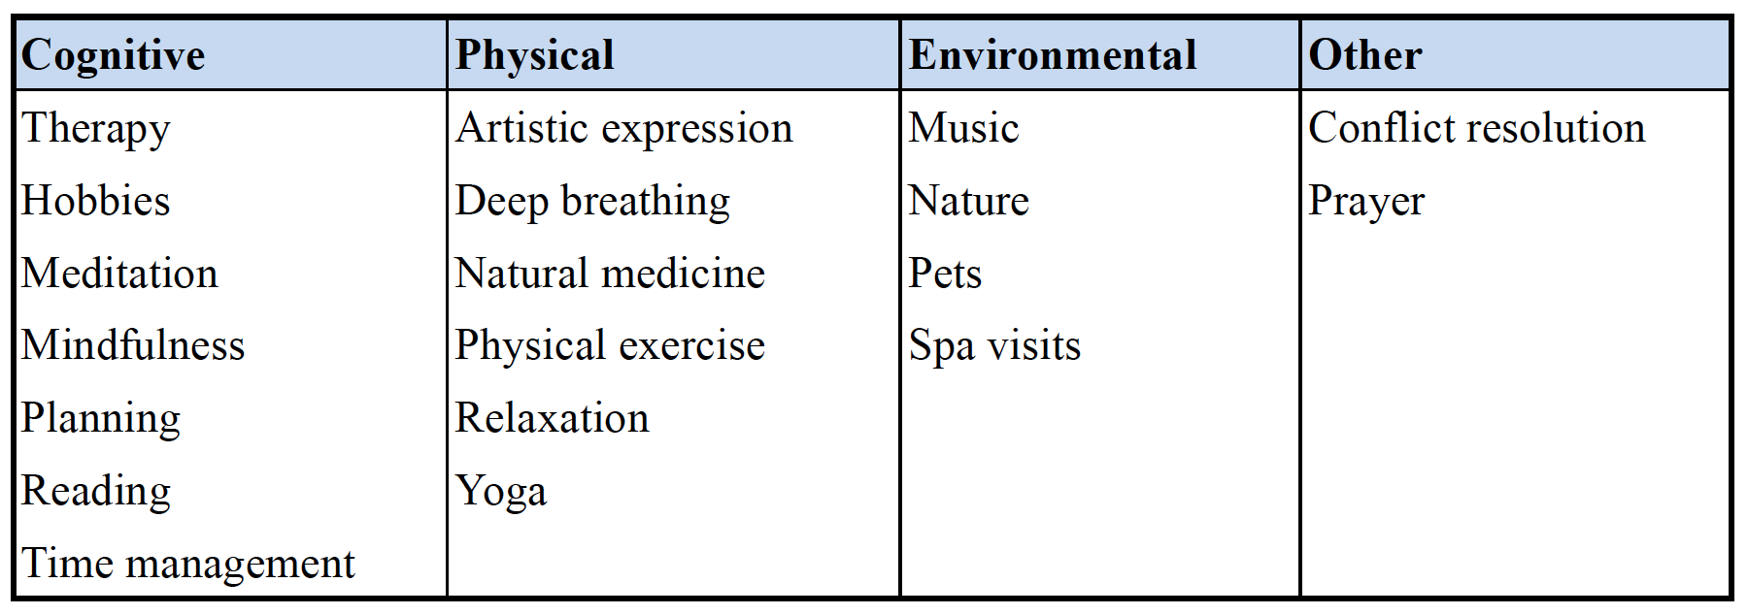

Stress and HEALTHY Coping
This Photo by Unknown Author is licensed under CC BY-SA-NC
This Photo by Unknown Author is licensed under CC BY

Slide 18
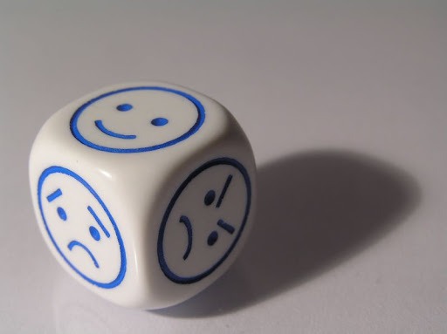
Physical Coping
Body awareness is a critical component for both stress management and keeping your emotions in a window of tolerance.
The advantage of being aware of your body signs is that you generally are more aware of tension than you are of your emotional state or even your thoughts!
Discriminate external awareness vs internal awareness.
Let’s talk about ways to cope on the body level…
This Photo by Unknown Author is licensed under CC BY-ND
Notes:
External awareness includes everything outside of your skin but accessible by your 5 senses.
Internal awareness is everything that happens in the skin…pains, sensations, thoughts, emotions
Purpose of discriminating external from internal is to help you learn to separate out all your experiences from the external world, or help you detach from your stressors.

Slide 19
Physical Coping: List of Body Awareness Practices and Coping
Putting the body in motion:
  Exercise
  Hike
  Bike riding
  Walking
  Swimming
  Stretching
  Low contact/impact sport
Nurture Your Body
  Eat HEALTY meals
  Sleep when you can
  Limit caffeine
  Limit or kick the ETOH habit
  Kick the nicotine habit
  Marijuana is not a panacea
Nourishing Body Practices
  Yoga
  Thai Chi
  Progressive muscle relaxation
  Body scan
  Mindfulness of the body exercise
  Mindful walk
  Mindfulness of pain or discomfort
  Let’s try one to practice!!

Slide 20
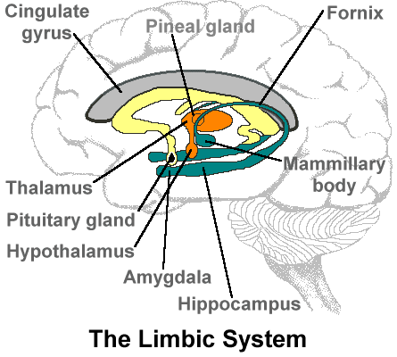
Emotional Coping
Emotions have both a physical component and a cognitive, or thinking, component.
Emotions provide you vital survival information.
There is a stronger evolutionary bias/advantage to hang on to negative information.
Let’s learn how to manage our emotions so they don’t manage us!
This Photo by Unknown Author is licensed under CC BY-NC-ND

Slide 21
Building Emotional IQ
How do you express emotions?
How are emotions expressed in the field?
How are emotions expressed at home?
How were emotions expressed in your childhood?
Are there safer emotions to express?
Notes:
First, start learning to identify the feeling you are experience. You can do this by noticing where in the BODY you feel the feeling. Use this chart to help you figure out what the emotion name is.
Start with the six basic emotions shown in the center. Find the charge that matches your mood, positive or negative. Then get more specific and choose which positive or negative emotion category fits. Then, go out to the next circle and choose the next level of feelings. Try this one more time with the last circle.

Slide 22
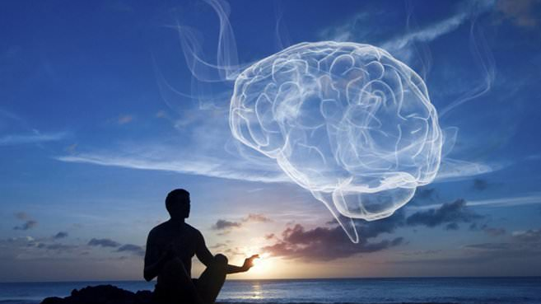
Emotional Coping: Dealing With Strong Feelings
Mindfulness exercises
  Breath
  Tolerance of feelings
  Gratitude
  Enhancing joy
This Photo by Unknown Author is licensed under CC BY-NC
Notes:
Emotional experiences do not last forever. Our brains are not permanently hijacked by stress hormones

Slide 23

Emotional Coping: Dealing with Strong Feelings
Problem Solving Time or Coping Time?
  Emotion Mind, Wise Mind, Logical Mind
    Does your emotion fit the facts?
    What’s more effective, action or coping?
This Photo by Unknown Author is licensed under CC BY-SA-NC

Slide 24

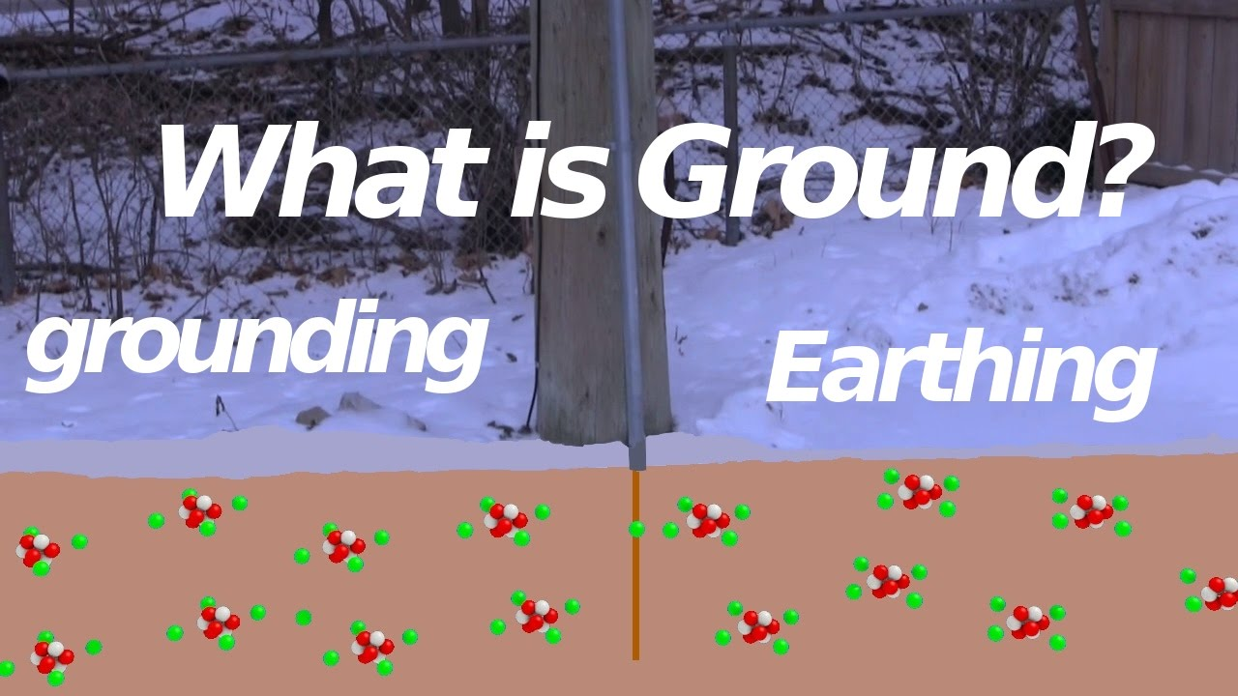
Emotional Coping: Skills
  Opposite Action
  Accumulate Positive Emotions Through Action
  Grounding-Look, Point, Name; 5 senses
  Holding ice
  Distraction
  Radical Acceptance
  Let’s Try one
This Photo by Unknown Author is licensed under CC BY
This Photo by Unknown Author is licensed under CC BY-SA

Slide 25
Cognitive Coping
“Just because I think it, does not make it true.”
Brain is an organ that produces thought like the pancreas produces insulin.
Role of Automatic Thoughts, Negative Coping, and Core Beliefs
Thought Traps…

Slide 26
Cognitive Coping: Thought Traps
Catastrophizing
Mental Filtering
Personalizing
Heavens Reward Fallacy
Fundamental Attribution Error
Emotional Reasoning
Strategies to cope cognitively…
Overgeneralization
All-Or-None
Minimizing/Maximizing
Catastrophizing
Mind Reading
Forecasting the future
Labeling

Slide 27
Cognitive Coping
Thought Evaluation
  Catch It-Check It-Change It
Refocusing
Mindful detachment from the thinking process
  Thoughts On A Cloud/Leaves On A Stream
Acceptance Strategies

Slide 28
Acceptance
Changing your relationship to stressors
  Control is the problem
    Making “it” go away or pushing it down
    Quicksand
  Letting go of the “fix it” reflex
  Detach from stressors
    When at home, watch your thought process.
      Separate the thought from thinking, emotion from feeler

Slide 29

Relationship Health and Wellness
This Photo by Unknown Author is licensed under CC BY

Slide 30
Healthy Relationships
Mutual respect.
Trust.
Honesty.
Compromise.
Individuality.
Good communication.
Source: https://youth.gov/youth-topics/teen-dating-violence/characteristics

Slide 31
Healthy Relationships
Anger control.
Fighting fair.
Problem solving.
Understanding.
Self-confidence.
Being a role model.
Healthy sexual relationship.

Slide 32
A Sound House
Aspects of your interactions and behaviors that can either grow or harm your relationship.
Level 1-Friendship
  Love Maps, Fondness and Admiration, Turning Towards
Level 2-Conflict
Level 3-Dreams and shared meaning
Pillars-Trust and Commitment

Slide 33
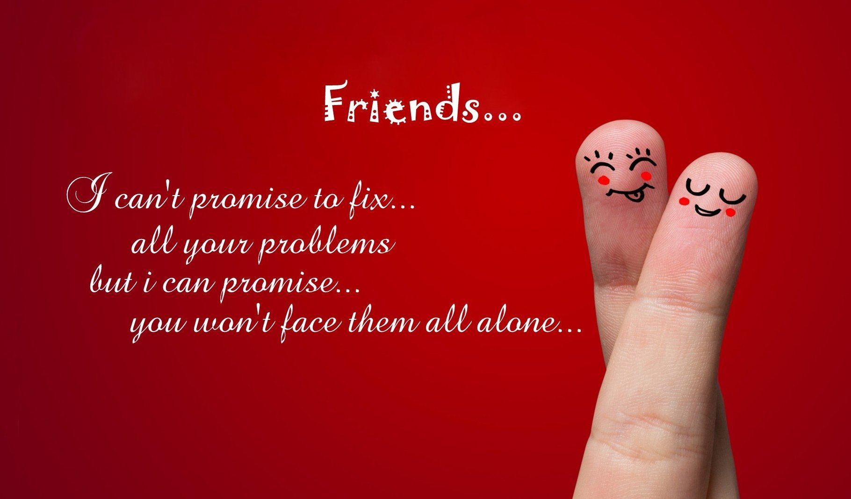
Work On Your Foundation
Friendship
  Foster Positive Feelings and Environment
  Love Maps: Ask questions, discuss hopes and dreams, get to know your partner.
    Find time to talk about things besides the kids, work, bills
  Fondness and Admiration:
    Focus on qualities, attributes, etc. that you love
    Express appreciation
  Turning Towards
    Find small frequent ways to express physical affection
    De-stress together
    Work on “we-ness” or us against the world mentality
  Build your friendship!
This Photo by Unknown Author is licensed under CC BY-NC

Slide 34
Relationship Skills Basics
Active listening
Open-ended questions
Understanding non-verbal communications and emotions

Slide 35

Active Listening Skills
Prepare Your Self
Focus
Reflect Back
Notes:
Poor communication → low morale, low trust, poor performance, hinders progress
Effective communication→ empowers employees, builds trust, helps navigation of organizational changes

Slide 36

Prepare
Prepare Your Self
  Clear your head.
  Suspend Your Agenda.
  Breathe/self-soothe.

Slide 37

Focus
Focus (a.k.a. pay attention)
  Take notes if you needed to.
  Avoid distractions.
  Make sure you understand what is said because in the next step you are going to summarize it.
This Photo by Unknown Author is licensed under CC BY-SA

Slide 38
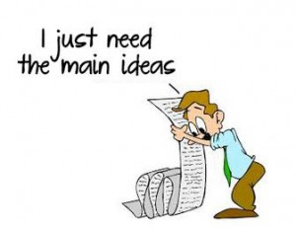
Reflecting Back
Reflect
  Summarize what was just said:
    “Let me see if I understand this…”
    “…did I get that right?”
    “So, what I hear you saying is…”
This Photo by Unknown Author is licensed under CC BY

Slide 39

Open Ended Questions
An aspect of Step Two in the previous slide.
Ask questions to aid in clarifying your understanding.
Avoid advice giving, criticisms, critiques in this phase.
Open ended questions cannot be answered with a “yes” or “no”
  Tell me more
  What do you mean
  How
  What
  When
This Photo by Unknown Author is licensed under CC BY-SA

Slide 40


Non-Verbal Communication
Facial expression-neutral face vs. happy face vs. Angry face…
Stance-open or closed?
Body position-relaxed arms/hands, gaze?
Distance-comfortable or in your face?
This Photo by Unknown Author is licensed under CC BY
This Photo by Unknown Author is licensed under CC BY-NC

Slide 41
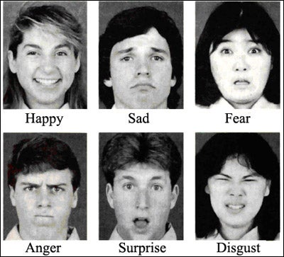
BASIC EMOTIONS
This Photo by Unknown Author is licensed under CC BY-SA-NC

Slide 42
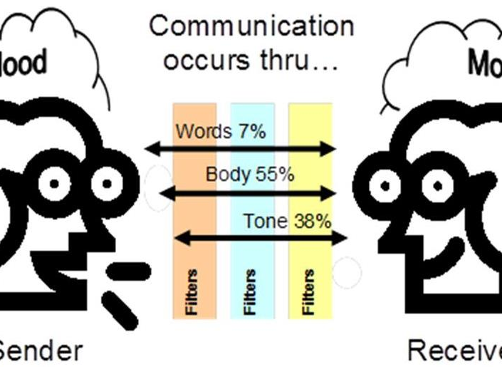
Communication Basics
Preparation
“I” statements
Challenges
Validations
Relationship killers
Antidotes
Aids
This Photo by Unknown Author is licensed under CC BY

Slide 43
Communicating With Spouses
Prepare Yourself
  Shift focus to them
  Suspend your agenda
  Be genuinely curious about where they are coming from or why they are communicating what they are communicating.
  Self-soothe
Attune
  Listen for understanding
  Again, you are going to need to reflect back what you heard so…
  Ask open-ended questions if you don’t understand
  Hold your reactions and focus on your partner’s emotional world
    What emotions are you seeing?
  Self-soothe
Reflect Back
  Summarize what you heard
  Low effort interaction with big payback
  Decreases defensiveness
  Helps the other feel heard

Slide 44
“I” Statements
Don’t use “you”
Use this formula:
  I feel…(insert emotion word)
  About…(describe situation objectively)
  I need (say what you need or want, not what you don’t need or want)

Slide 45


Communication Challenge
Which Channel Does Your Partner Need You On?
  Listening
  Problem-Solving
Notes:
Ask what your partner needs because so frequently we all jump to problem-solving mode and miss the point of the interaction → CONNECTION and VALIDATION
Only give advice when it is asked for, otherwise it is unsolicited and may not be appreciated

Slide 46
Ineffective Responding To Emotions
Anger
  Don’t personalize mere expressions
    Where is the anger coming from
    What is in the way
  If you are the object, self-soothe, hear, accept responsibility when appropriate
    Active listening
    Problem solving
Sadness
  Don’t fix it
  Hear it
  Reflect back
  Acknowledge
  If you caused it, acknowledge, accept ownership, repair
Fear
  Hear concerns, summarize, validate
  If you are the object, acknowledge, accept ownership, repair

Slide 47

Validating Statements
That sounds awful.
That must be difficult.
You are having a hard time.
This must be confusing for you.
That makes sense.
You are angry/sad/irritated.
I support you.
How can I help you?
What do you need from me?
You’re in a tough spot.
It makes sense why…
This Photo by Unknown Author is licensed under CC BY-NC-ND

Slide 48
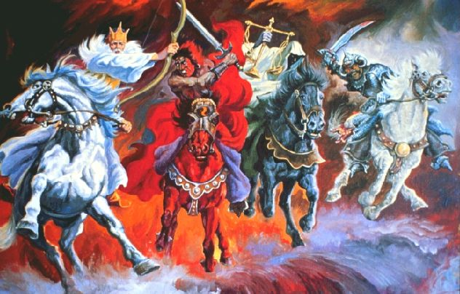
Relationship Killers: The Four Horsemen of the Apocalypse
Criticism
Defensiveness
Contempt
  Form of emotional abuse
Stonewalling
This Photo by Unknown Author is licensed under CC BY-ND

Slide 49
Antidotes
Notes:
Contempt-Statement of your feeling
Communicate request or longing
Invitation to open discussion

Slide 50
Aids
Small Things Often Podcast
  https://www.gottman.com/podcast/
Card deck App
Couple Counseling
Notes:
https://www.gottman.com/podcast/

Slide 51
Unhealthy Relationships
Control.
Hostility.
Dishonesty.
Disrespect.
Dependence.
Intimidation.
Physical violence.
Sexual violence.
Relationship Warning Signs
Notes:
https://www.youtube.com/watch?v=XxtSVM1c_HU

Slide 52
Moving into Domestic Violence

Slide 53
Domestic Violence
Situational Couple Violence
  Stress, conflict, escalation
    Poor coping
    No skills
    Remorse
Intimate partner terrorism.
  Pattern of control
  Dominance
  Cultural-rooted in patriarchal tradition of male dominance
Distinguished by presence of control not severity or type of violence used***
Either can be dangerous or deadly
Undermines victims' mental health-may question reality
May feel they are to blame
May have experienced invalidation and lack of support by others
Johnson MP. A Typology of Domestic Violence: Intimate Terrorism, Violent Resistance, and Situational Couple Violence. Boston, MA: Northeastern University Press; 2008.

Slide 54
DV: IPT Movie Example
Control and fear
Apology
DV Scene

Slide 55
IPT Victims Health and Other Consequences
Depression
Anxiety
PTSD
Injuries
Sexual Assault
Risk death/murder
Economic
  Keeping partner away from finances
  Sabotaging work
    Beatings before work or before interviews
    Unreliable for childcare
    Withholding transportation
    Harassment at work
    Turn off alarms

Slide 56
IPT Explained
Based on power, control, dominance, manipulation
Personality disorders are a risk factor, but mental health issues are NEVER an excuse
Learned behavior
Disregard for CONSENT
Are you in an abusive relationship or do you engage in some of these behaviors?
  See DVAssist.org
  https://dvassist.org.au/am-i-experiencing-domestic-violence/unhealthy-vs-healthy-relationships/
  Quizzes on relationship abuse
Notes:
Abuse is a learned behavior. Some people witness it in their own families growing up; others learn it slowly from friends, popular culture, or structural inequities throughout our society. No matter where they develop such behaviors, those who commit abusive acts make a choice in doing so — they also could choose not to.
There are many people who experience or witness abuse who use their experiences to end the cycle of violence and heal themselves without harming others. While outside factors (including drug or alcohol addiction) can escalate abuse, it’s important to recognize that these issues do not cause domestic abuse themselves.

Slide 57
Domestic Violence Types
Domestic violence can be physical, emotional, psychological
  Types include:
    Physical
    Emotional
    Social
It can occur between partners, in families, between adults, among parents, children, grandparents, siblings.
    Financial
    Digital
    Spiritual/Cultural
    Stalking
    Sexual
    Reproductive
    Visa
Notes:
Domestic violence (also referred to as intimate partner violence (IPV), dating abuse, or relationship abuse) is a pattern of behaviors used by one partner to maintain power and control over another partner in an intimate relationship.
SOURCE: National Violence Domestic Hotline

Slide 58
Warning Signs (a.k.a. Tactics)
Emotional Abuse
Checking your social media or phone without your permission
Trying to limit you from seeing your family and friends or preventing you from doing things you enjoy
Making you feel scared, anxious or intimated
Trying to keep in constant contact with you during the day and becoming angry if you are unresponsive
Putting you down or criticizing you
Making you feel as though everything you do is wrong
Accusing you of being unfaithful or flirting with others
Needing to know where you are all the time
Controlling aspects of your life, for example what you wear or who you spend your time with
Threatening to hurt you, your children or your pets

Slide 59
DV Cycle
Cyle Explained

Slide 60
Domestic Violence…
Is never ok.
  Doesn’t matter what is causing it, it is never acceptable to abuse others.
  Accountability is important.
Seek out information and resources to:
  Support survivors and prevent unnecessary blaming, shaming or double victimization.
  Know how to help avoid putting them at greater risk.
Anyone can be a victim or abuser.
If you recognize that you are doing some of these behaviors:
  Call the National Domestic Violence Hotline. They have resources to assist in treatment.
  Seek anger management and specialized therapy

Slide 61

Questions?

Slide 62
Thank You.

